Slide 1

Phonics in Reception

Slide 2
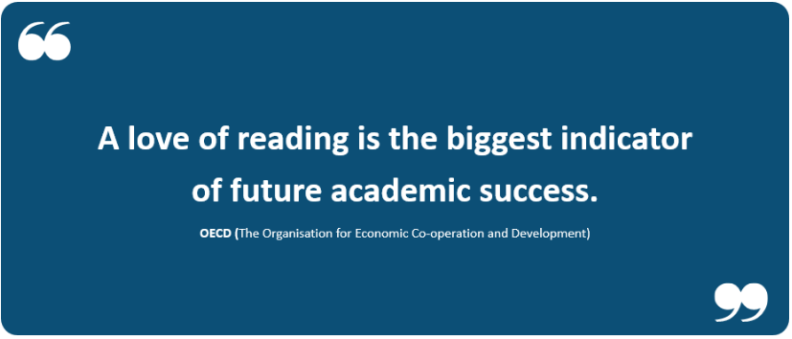

Slide 3




How many times have you read today?

Slide 4
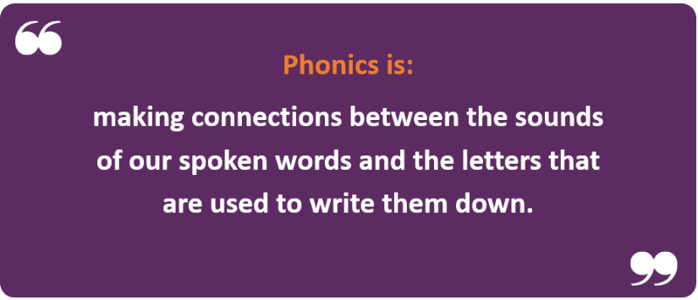
What is phonics?
At Worstead we use Little Wandle Letters and Sounds Revised

Slide 5
Terminology
Phoneme - The smallest unit of sound that can be identified in words.
Grapheme - A letter or group of letters used to represent a particular phoneme when writing.
Digraph - A grapheme using two letters to represent one phoneme (ch/sh/ng)
Trigraph - A grapheme using three letters to represent one phoneme (igh/air)
Blend - To combine individual graphemes into a whole word.
Segment - To identify each of the individual phonemes in a word.

Slide 6

Phonemes
Not taught in alphabetical order.
Pronunciation is important. Use clear sounds.
https://www.littlewandlelettersandsounds.org.uk/resources/for-parents/

Slide 7
Blending
We teach blending so your child learns to read
Teacher led blending is taught throughout Phase 2.
Our aim is that every child is blending by Christmas.
We will inform you if your child needs additional pracitce.
How we teach blending:
https://www.littlewandlelettersandsounds.org.uk/resources/for-parents/#tabnametabHowWeTeach

Slide 8
Tricky Words
These words have unusual spellings e.g. he, was my.
Teachers identify what is tricky about the word.
Once children become familiar with these words they can then read them by sight.
This term we shall be learning: is I the

Slide 9

Spelling
Your child will be taught how to spell simple words, using the graphemes they have been taught.
They will practise the correct formation of letters and will also have handwriting lessons.
We teach spelling by:
Say the word.
Segment the sounds.
Count the sounds.
Write them down.

Slide 10
Reading books
Reading practise/ phonetically decodable book (Fluency and confidence is our aim)
(The Big Cat Books)
Sharing Book (Modelling reading skills and vocabulary)
(These are from the shelf or boxes in our classroom and for you to read to your child)
Reading record (Yellow book):
Please only record the books your child reads to you.
If they read at home they receive stamps on the yellow card. Once their stamp card is full they receive a special certificate.

Slide 11
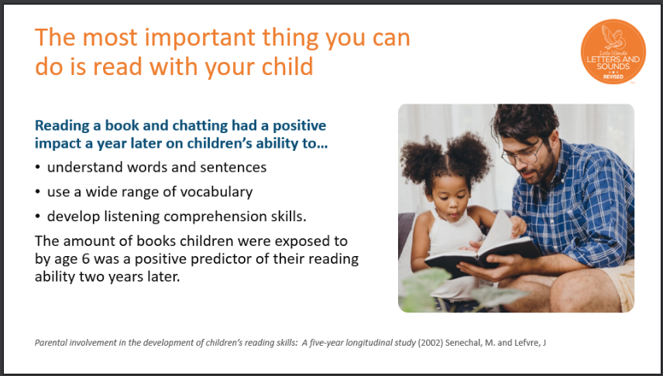

Slide 12
Helping your child at home . . .
Make it fun!
Rhyming games
Oral blending games
Read to children, read with them, listen to them
Make up stories together
Let them see you reading
Celebrate their success!

Slide 13
You can find lots more information about Little Wandle Letters and Sounds on the following link. It has some very useful videos which demonstrate reading and phonics in school.
https://www.littlewandlelettersandsounds.org.uk/resources/for-parents/

